Slide 1

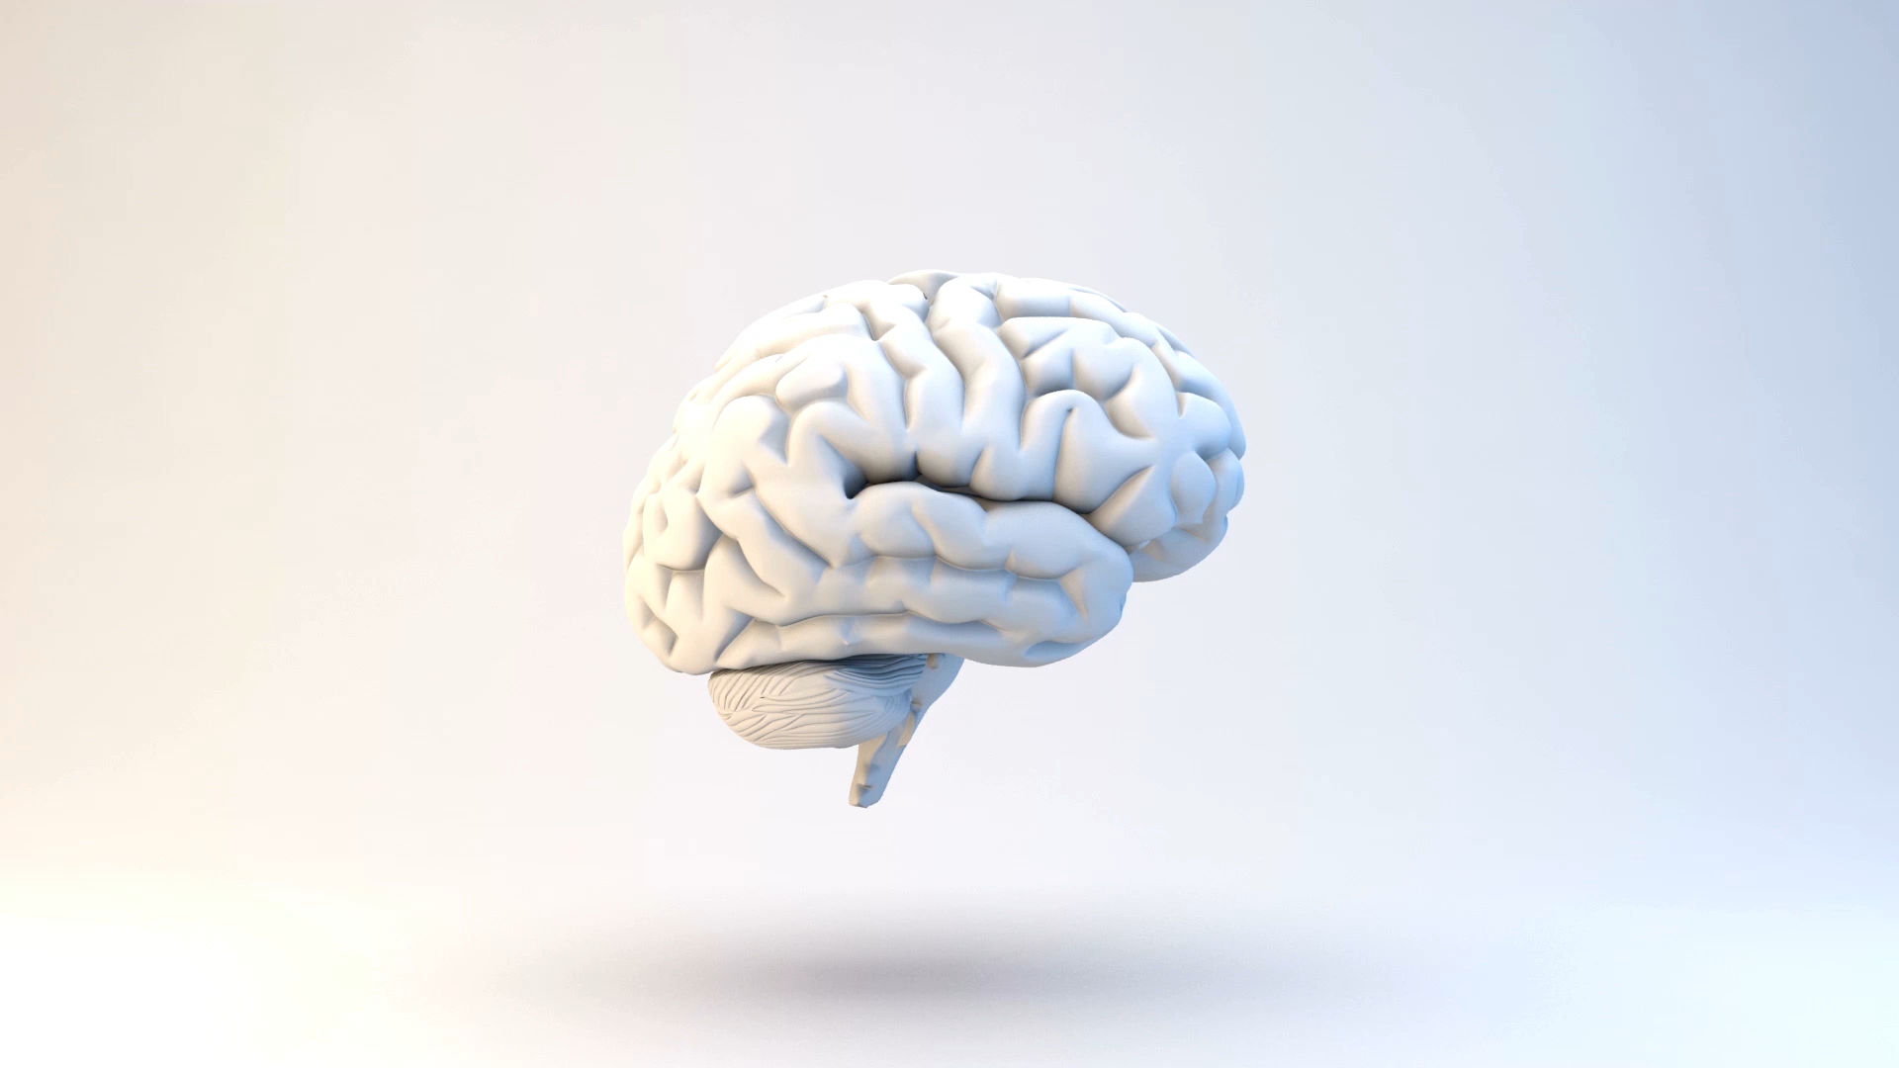
脑机接口 Brain Computer Interface(BCI)
课程:先进机器人技术
汇报:陈凯旋

Slide 2

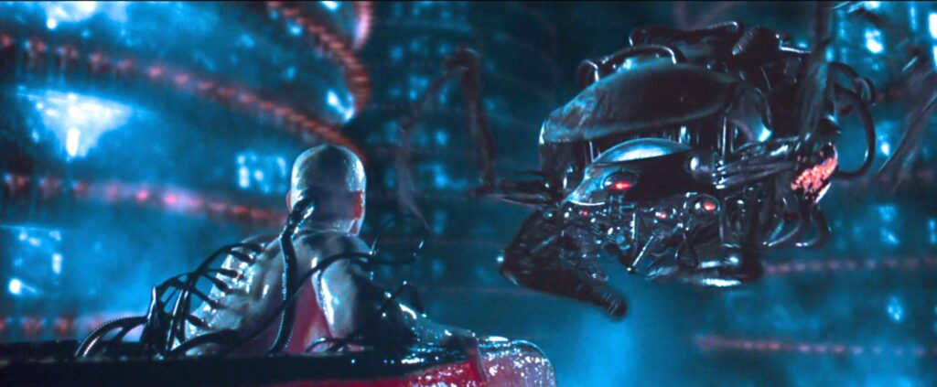
黑客帝国 The Matrix
主人公从缸中之脑醒来，见到母体
刀剑神域 Sword Art Online
主人公刚刚佩戴上NerveGear

Slide 3
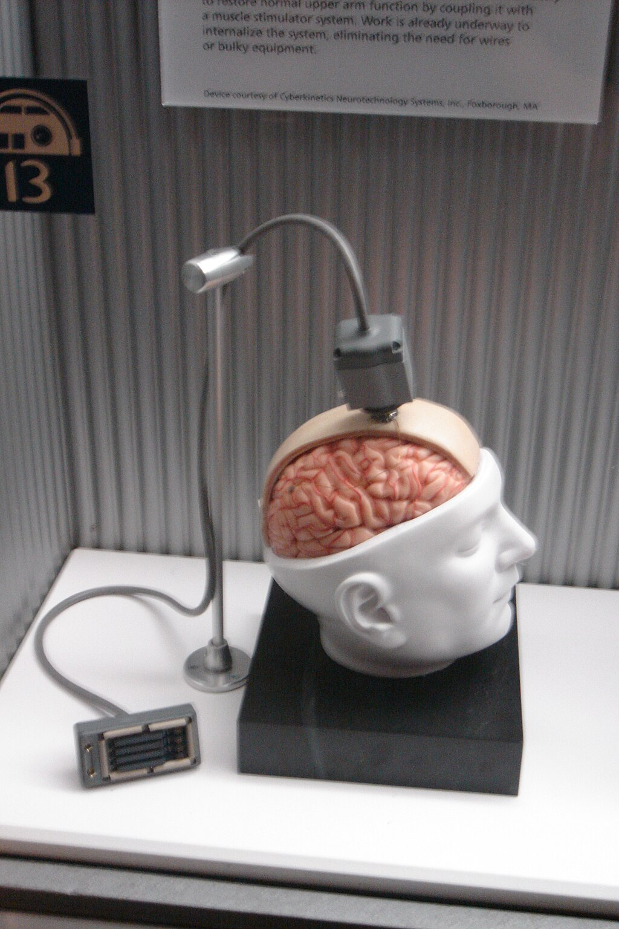
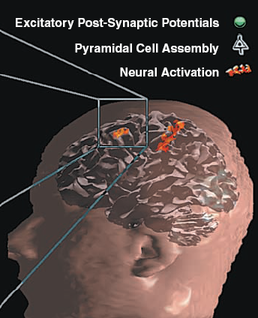
脑机接口 Brain Computer Interface(BCI)/Brain Machine Interface(BMI)
是脑电活动与外部设备（通常是计算机或机器人肢体）之间的直接通信连接
常用于研究、绘制、辅助、增强或修复人类的认知或感觉运动功能
神经可塑性 Neuroplasticity
大脑重组和重新连接其神经连接的能力，使其能够以不同于先前状态的方式进行适应和运作。
Image Source: Cyberkinetics - Wikipedia

Slide 4
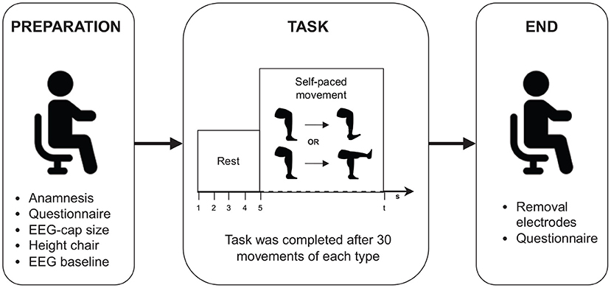
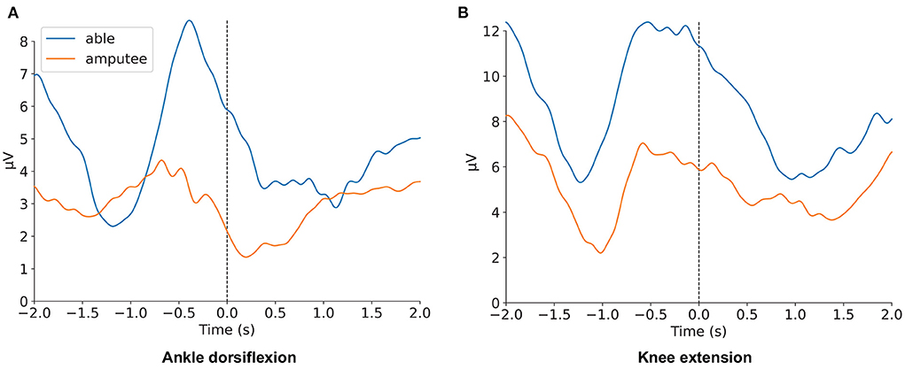
可塑性：重复训练 → 突触重组
信号优化 → 解码精准
健康和截肢者进行相同的腿部动作
持续学习与优化
个性化定制
截肢个体和身体健全个体在同种运动中与运动准备GFP模式存在偏差
Reference: Dillen, A., Lathouwers, E., Miladinović, A., Marusic, U., Ghaffari, F., Romain, O., ... & De Pauw, K. (2022). A data-driven machine learning approach for brain-computer interfaces targeting lower limb neuroprosthetics. Frontiers in human neuroscience, 16, 949224.

Slide 5
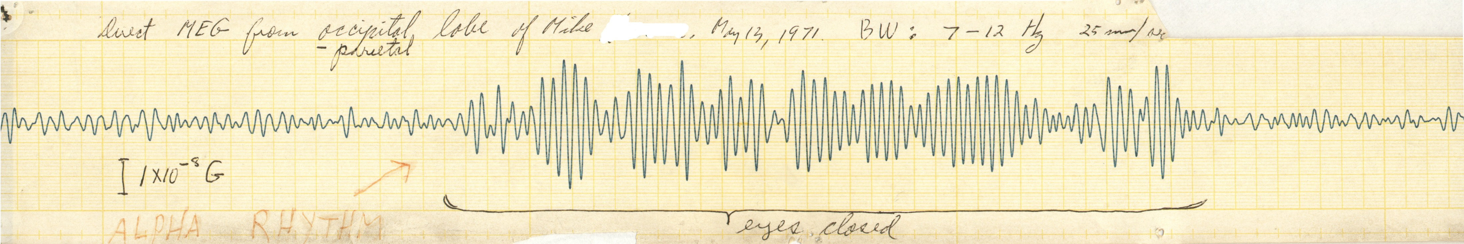
大脑特性
BCI 系统
核心问题
BCI的商业公司和广泛商业化的产品
介绍文献检索策略和引用的文献
在麻省理工学院, Cohen 博士的房间里用 SQUID 探测器首次测量到清晰的 MEG(脑磁图)

Slide 6
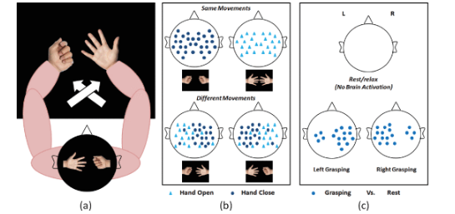
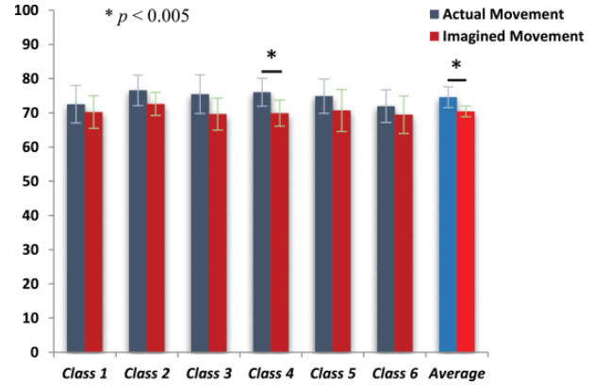
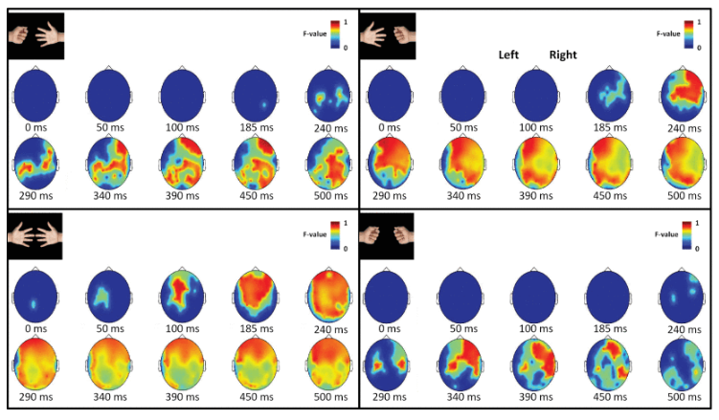

意念的初步显现：BCI与动作识别
进行真实动作与想象动作的对比实验
真实运动的神经表征相对一致性
想象运动的个体差异显著
运动的执行与想象的神经机制可能存在差异
受试者进行不同动作时
对应不同的大脑激活范式$α、β$波段
Reference: Belkacem, A. N., Nishio, S., Suzuki, T., Ishiguro, H., & Hirata, M. (2018). Neuromagnetic decoding of simultaneous bilateral hand movements for multidimensional brain–machine interfaces. IEEE Transactions on Neural Systems and Rehabilitation Engineering, 26(6), 1301-1310.

Slide 7
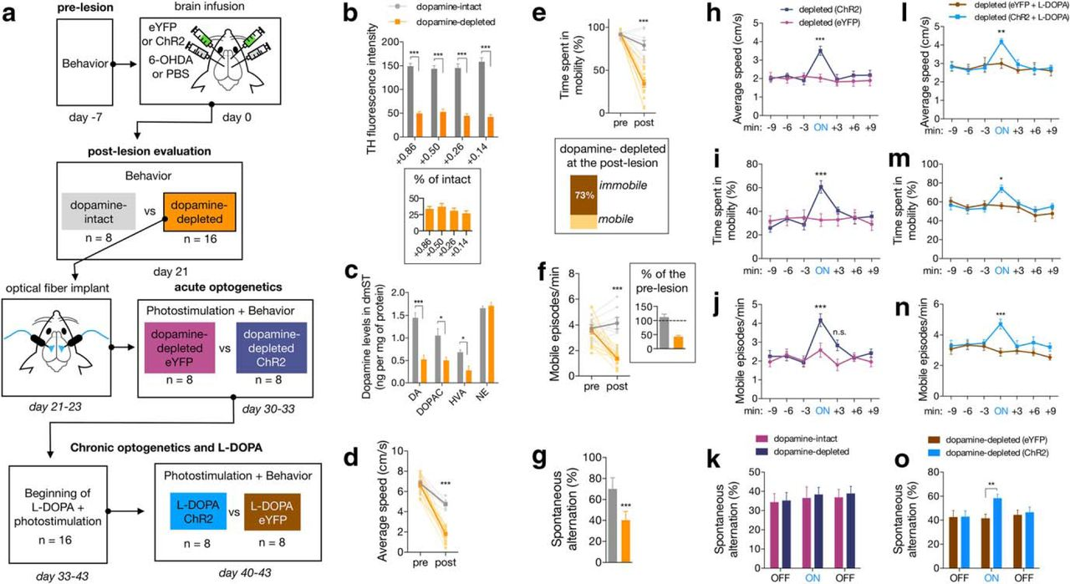
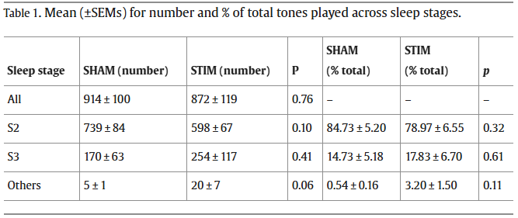
意念的反馈控制：BCI与外界刺激
光遗传学刺激可逆转帕金森病小鼠的运动功能障碍
有节奏的声学刺激促进依赖性陈述性记忆
(通过慢波睡眠)
STIM(刺激)SHAM(无刺激)
Reference: Ong, J. L., Lo, J. C., Chee, N. I., Santostasi, G., Paller, K. A., Zee, P. C., & Chee, M. W. (2016). Effects of phase-locked acoustic stimulation during a nap on EEG spectra and declarative memory consolidation. Sleep medicine, 20, 88-97.
Magno, L. A. V., Tenza-Ferrer, H., Collodetti, M., Aguiar, M. F. G., Rodrigues, A. P. C., da Silva, R. S., ... & Romano-Silva, M. A. (2019). Optogenetic stimulation of the M2 cortex reverts motor dysfunction in a mouse model of Parkinson's disease. Journal of Neuroscience, 39(17), 3234-3248.

Slide 8
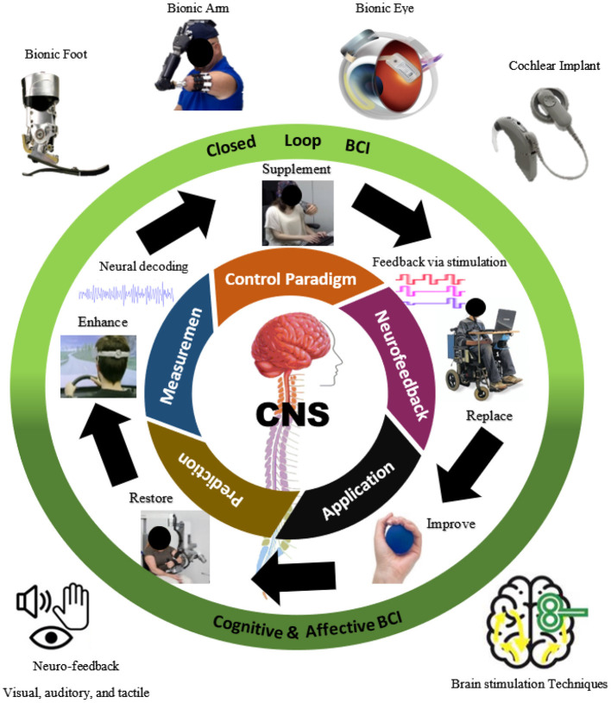
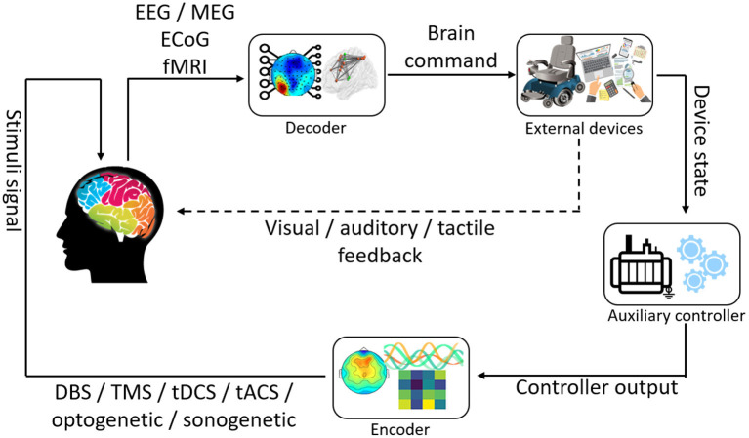
BCI 系统
基于反馈脑刺激的闭环 BCI 系统
基于脑机接口 （BCI） 的闭环脑反馈或刺激控制
Reference: Belkacem, A. N., Jamil, N., Khalid, S., & Alnajjar, F. (2023). On closed-loop brain stimulation systems for improving the quality of life of patients with neurological disorders. Frontiers in human neuroscience, 17, 1085173.

Slide 9
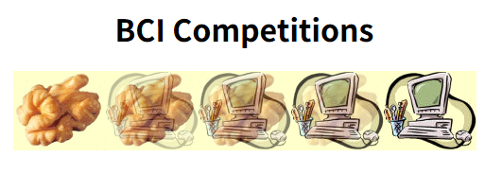
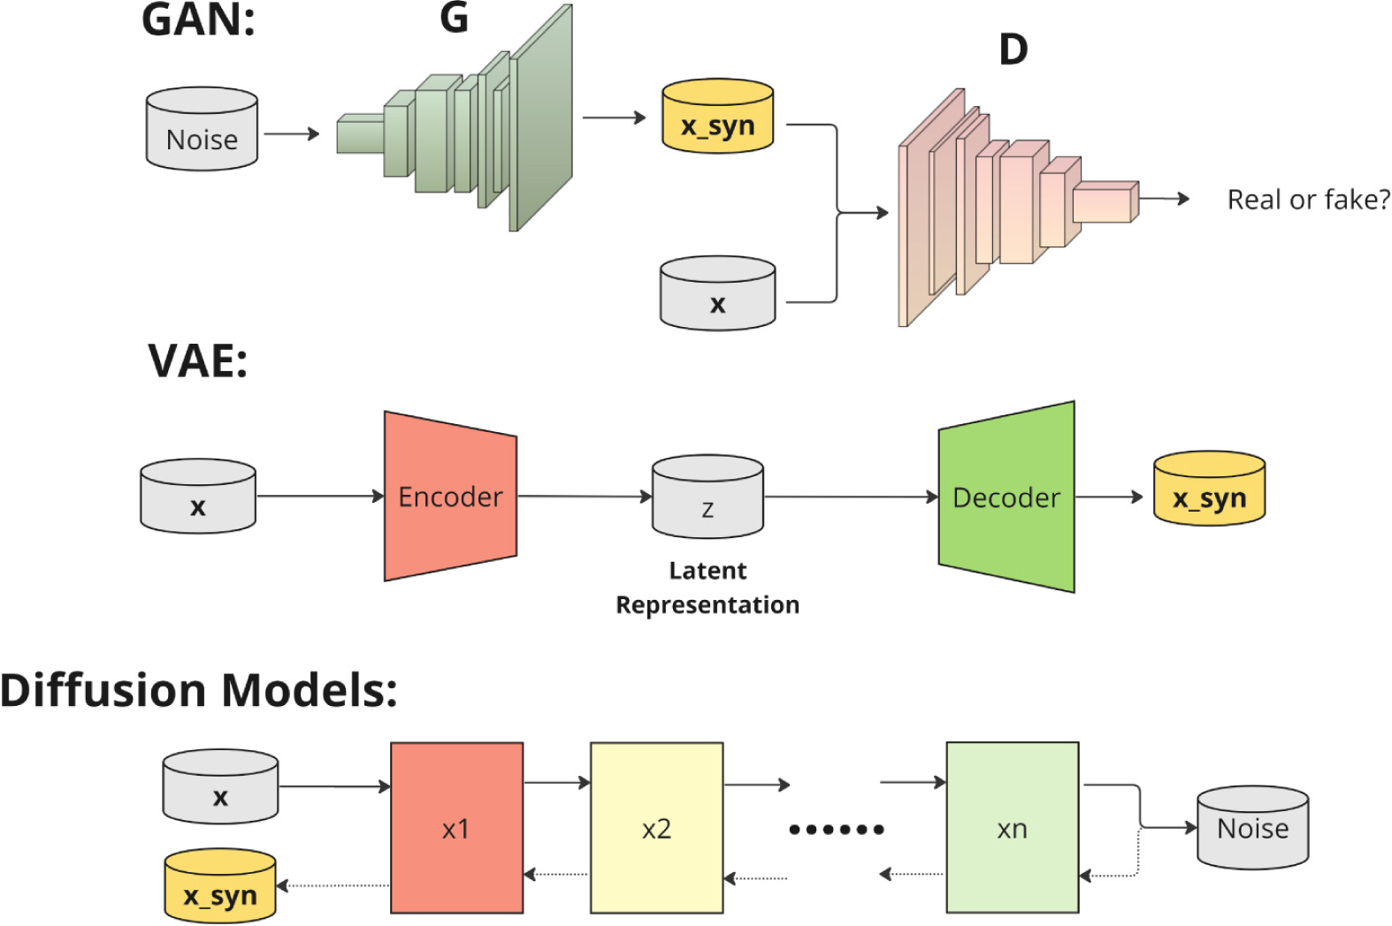
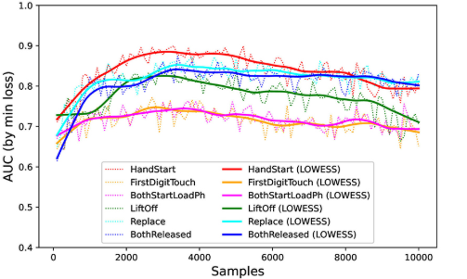
BCI 核心问题
数据问题:
~2008,大都采用改进的SVM方法(传统机器学习算法)
基于学习的方法
问题仍然存在
Reference: Gordienko, Y., Gordienko, N., Taran, V., Rojbi, A., Telenyk, S., & Stirenko, S. (2025). Effect of natural and synthetic noise data augmentation on physical action classification by brain–computer interface and deep learning. Frontiers in Neuroinformatics, 19, 1521805. Ibrahim, M., Al Khalil, Y., Amirrajab, S., Sun, C., Breeuwer, M., Pluim, J., ... & Dumontier, M. (2025). Generative AI for synthetic data across multiple medical modalities: A systematic review of recent developments and challenges. Computers in biology and medicine, 189, 109834.
Wierzgała, P., Zapała, D., Wojcik, G. M., & Masiak, J. (2018). Most popular signal processing methods in motor-imagery BCI: a review and meta-analysis. Frontiers in neuroinformatics, 12, 78.

Slide 10
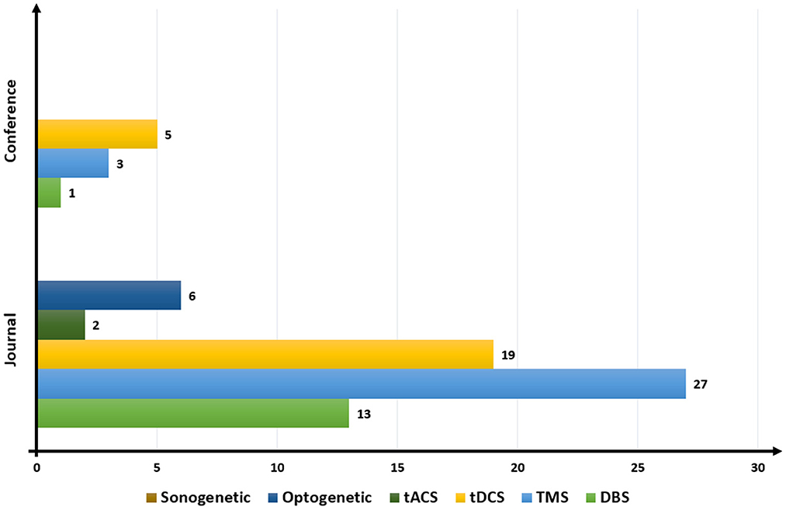
BCI 核心问题
安全问题:
只有 DBS 和 TMS 已获得美国食品和药物管理局 （FDA） 的批准
DBS 是一种微创手术治疗，但存在相当大的风险。
基于脑刺激的出版趋势。DBS，脑深部刺激;TMS，经颅磁刺激;tDCS，经颅直流电刺激;tACS，经颅交流电刺激。
Reference: Belkacem, A. N., Jamil, N., Khalid, S., & Alnajjar, F. (2023). On closed-loop brain stimulation systems for improving the quality of life of patients with neurological disorders. Frontiers in human neuroscience, 17, 1085173.

Slide 11
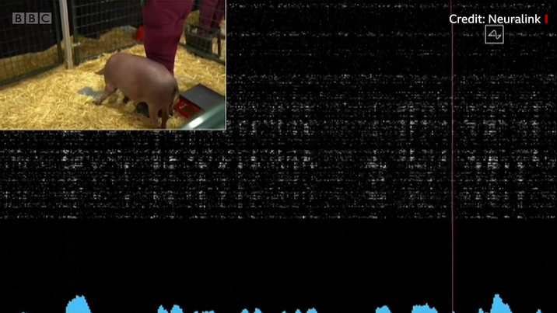
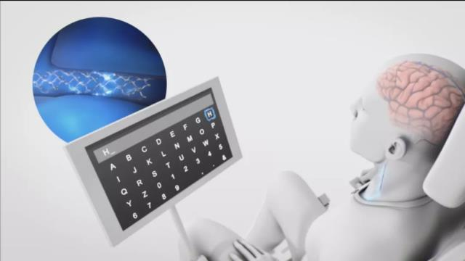
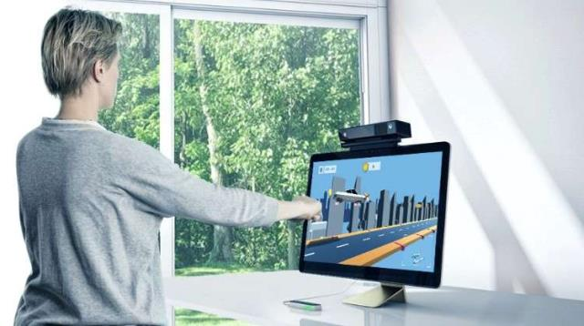
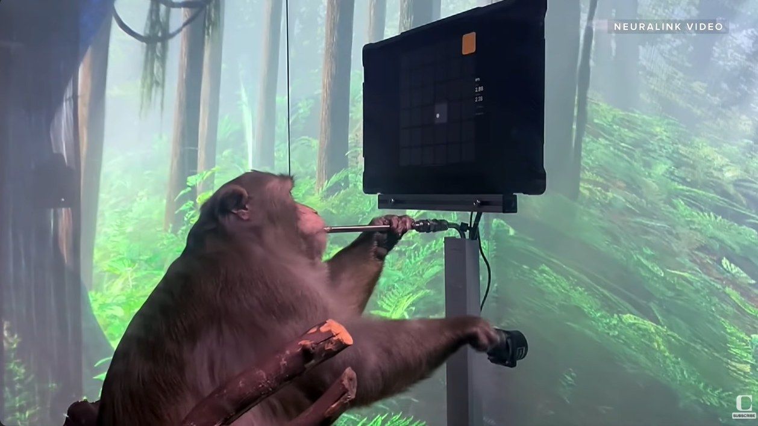
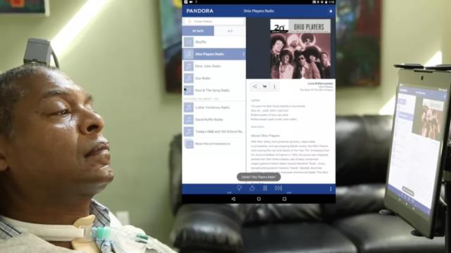
BCI 商业应用
Neurallink
Synchron
MindMaze
BrainGate
2018
Image Source: 国家高性能医疗器械创新中心，BBC，CNET Highlights,布朗大学

Slide 12
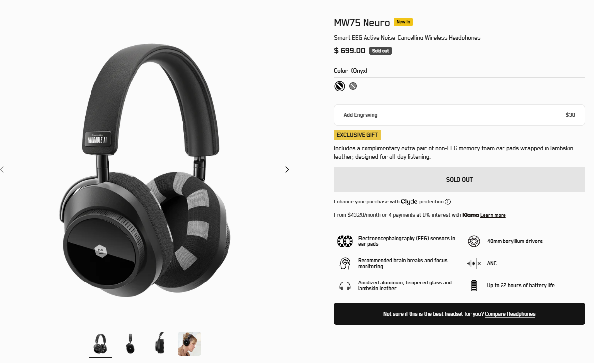
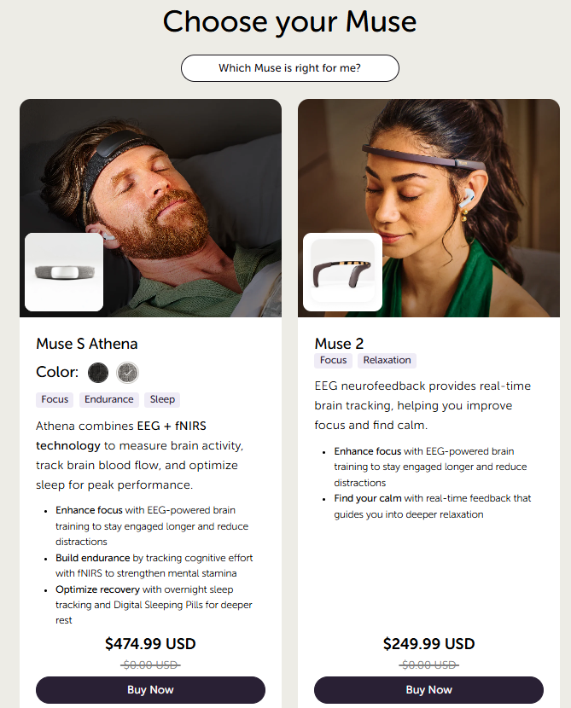
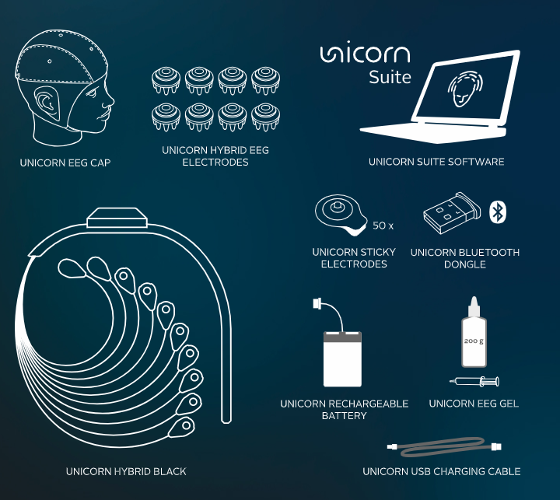
BCI 商业产品
Master & Dynamic
与Neurable
合作开发的
MW75 Neuro耳机
InteraXon的Muse系列脑机接口头环
g.tec
intendiX/Unicorn Speller
~1000欧元

Slide 13
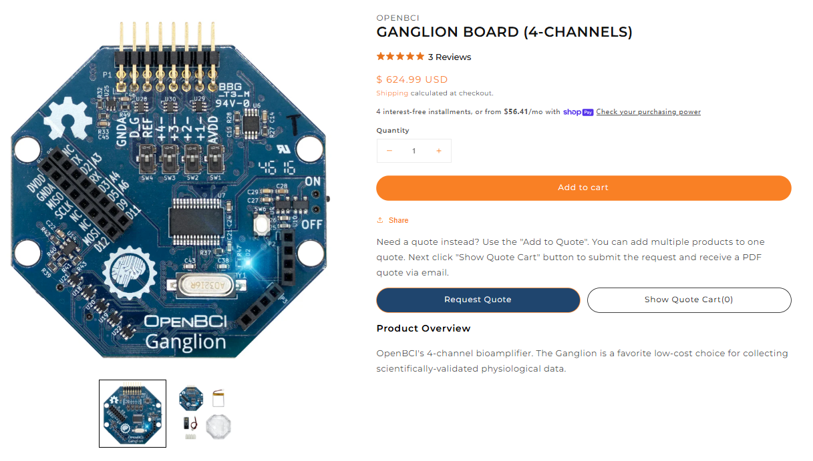
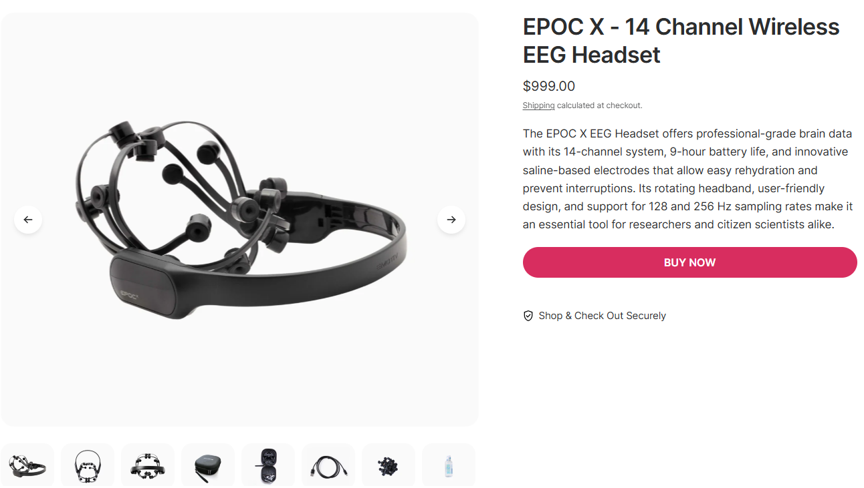
BCI 商业产品
OpenBCI (Cyton/Ganglion)
Emotiv EPOC X - 14 Channel Wireless EEG Headset

Slide 14
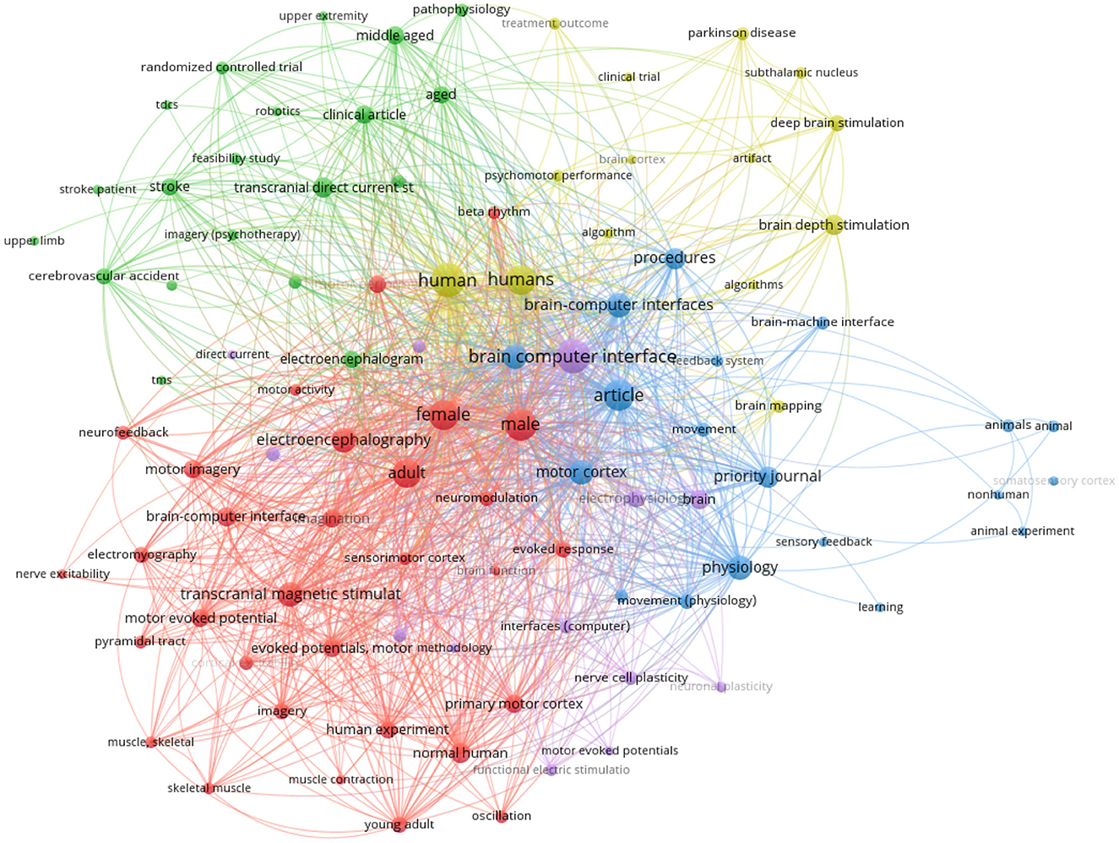
BCI文献检索策略
遵循The PRISMA statement for reporting systematic reviews and meta-analyses of studies that evaluate health care interventions: explanation and elaboration
检索数据库: IEEEXplore、Scopus 和 PubMed。
选择的文章都至少符合标准之一:
(1)是使用并专注于脑刺激的研究
(2)是专注于闭环BCI模型的研究
(3)是得出患者大脑功能改善、增强或恢复结论的文章
(4)包含涉及健康或不健康参与者或动物的实验。
(5)是专注于改进或比较机器学习或某些算法的文章
基于闭环 BCI 的脑刺激关键词出现的文献计量分析
Reference: Belkacem, A. N., Jamil, N., Khalid, S., & Alnajjar, F. (2023). On closed-loop brain stimulation systems for improving the quality of life of patients with neurological disorders. Frontiers in human neuroscience, 17, 1085173.
Liberati, A., Altman, D. G., Tetzlaff, J., Mulrow, C., Gøtzsche, P. C., Ioannidis, J. P., ... & Moher, D. (2009). The PRISMA statement for reporting systematic reviews and meta-analyses of studies that evaluate healthcare interventions: explanation and elaboration. Bmj, 339.

Slide 15
文献参考（APA标准）
Belkacem, A. N., Jamil, N., Khalid, S., & Alnajjar, F. (2023). On closed-loop brain stimulation systems for improving the quality of life of patients with neurological disorders. Frontiers in human neuroscience, 17, 1085173.
Dillen, A., Lathouwers, E., Miladinović, A., Marusic, U., Ghaffari, F., Romain, O., ... & De Pauw, K. (2022). A data-driven machine learning approach for brain-computer interfaces targeting lower limb neuroprosthetics. Frontiers in human neuroscience, 16, 949224.
Ong, J. L., Lo, J. C., Chee, N. I., Santostasi, G., Paller, K. A., Zee, P. C., & Chee, M. W. (2016). Effects of phase-locked acoustic stimulation during a nap on EEG spectra and declarative memory consolidation. Sleep medicine, 20, 88-97.
Magno, L. A. V., Tenza-Ferrer, H., Collodetti, M., Aguiar, M. F. G., Rodrigues, A. P. C., da Silva, R. S., ... & Romano-Silva, M. A. (2019). Optogenetic stimulation of the M2 cortex reverts motor dysfunction in a mouse model of Parkinson's disease. Journal of Neuroscience, 39(17), 3234-3248.
Gordienko, Y., Gordienko, N., Taran, V., Rojbi, A., Telenyk, S., & Stirenko, S. (2025). Effect of natural and synthetic noise data augmentation on physical action classification by brain–computer interface and deep learning. Frontiers in Neuroinformatics, 19, 1521805.
Ibrahim, M., Al Khalil, Y., Amirrajab, S., Sun, C., Breeuwer, M., Pluim, J., ... & Dumontier, M. (2025). Generative AI for synthetic data across multiple medical modalities: A systematic review of recent developments and challenges. Computers in biology and medicine, 189, 109834.
Liberati, A., Altman, D. G., Tetzlaff, J., Mulrow, C., Gøtzsche, P. C., Ioannidis, J. P., ... & Moher, D. (2009). The PRISMA statement for reporting systematic reviews and meta-analyses of studies that evaluate healthcare interventions: explanation and elaboration. Bmj, 339.
Wierzgała, P., Zapała, D., Wojcik, G. M., & Masiak, J. (2018). Most popular signal processing methods in motor-imagery BCI: a review and meta-analysis. Frontiers in neuroinformatics, 12, 78.

